Slide 1

Analysis of Population Age and Residential Rental Prices
Dustin M. Kraft
Data Management/Analytics Undergraduate Capstone - D195

Slide 2
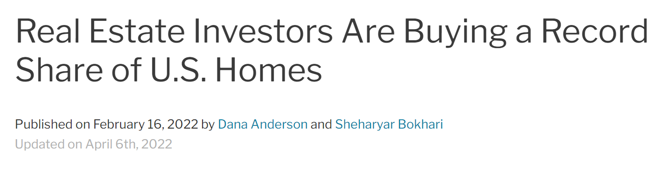
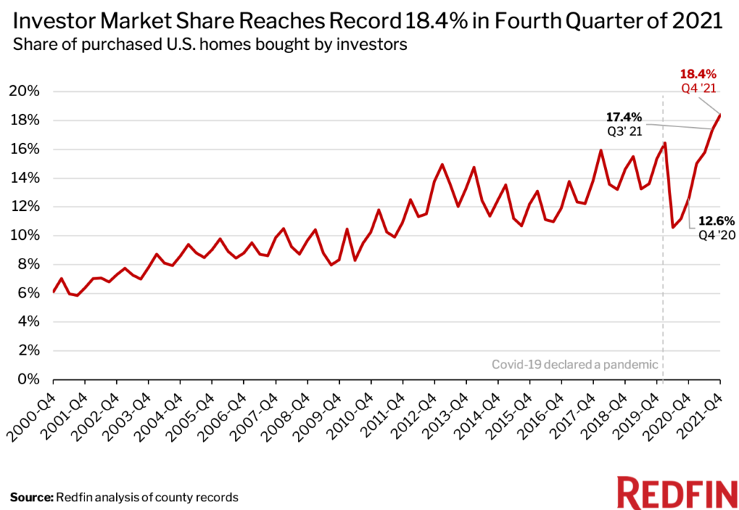
The Real Estate Investment Boom
(Anderson, 2022)

Slide 3
Question:
Can population age be used to predict higher residential rents for investor market assessments?

Slide 4
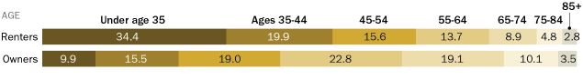

Renters
“Younger people – those below the age of 35 – are far more likely to rent than are other age groups: About two-thirds (65.9%) of this age group lives in rentals.”
(DeSilver, 2021)

Slide 5
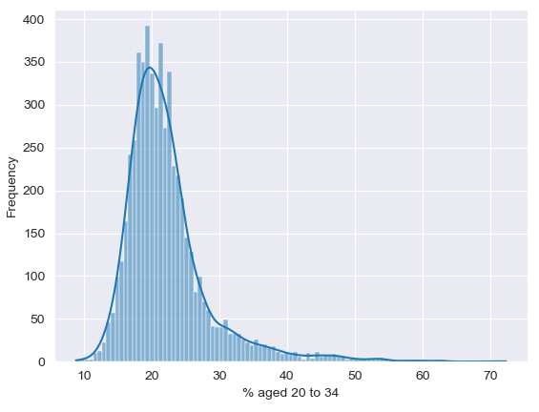
Percentage of population aged 20 to 34
By Zip Code Tabulation Area:
Mean: 22.29
Median: 21.0
Mode: 19.5
Variance: 41.21
Standard Deviation: 6.42

Slide 6
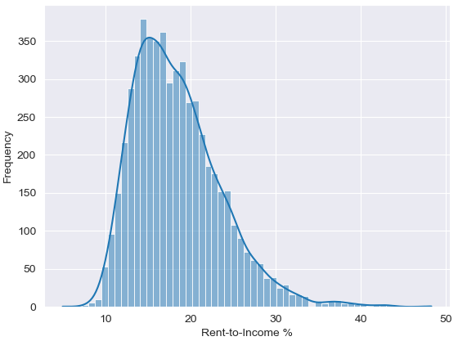
Rent-to-Income Ratio
By Zip Code Tabulation Area:
Median Rent / Median Income
Mean: 18.4
Median: 17.58
Mode: 23.07
Variance: 26.83
Standard Deviation: 5.18

Slide 7
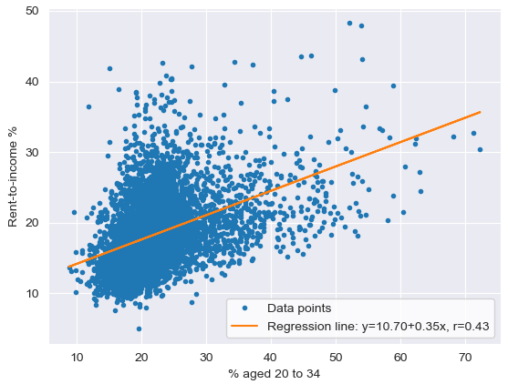
Regression Analysis
Slope: 0.345
Intercept: 10.70
p-value: 1.9301994559238115e-247
(0.00)
r-value: 0.43

Slide 8
Results
Criterion/Metric | Required Data | Cut Score for Success | Results
Regression Coefficient | Slope of the regression line | > 0 | 0.35
Measure of Significance | p-value | < 0.05 | 0.00
Correlation Coefficient | r-value | > 0.5 | 0.43

Slide 9
Sources:
Anderson, D. (2022, April 6). Real estate investors are buying a record share of U.S. homes. Redfin Real Estate News. Retrieved July 14, 2022, from https://www.redfin.com/news/investor-home-purchases-q4-2021/
DeSilver, D. (2021, August 3). As national eviction ban expires, a look at who rents and who owns in the U.S. Pew Research Center. Retrieved July 14, 2022, from https://www.pewresearch.org/fact-tank/2021/08/02/as-national-eviction-ban-expires-a-look-at-who-rents-and-who-owns-in-the-u-s/

